Slide 1
IoT Byte-Sized: IoT Data Management
WELCOME!
Allen R. Sanders
Senior Technology Instructor

Slide 2

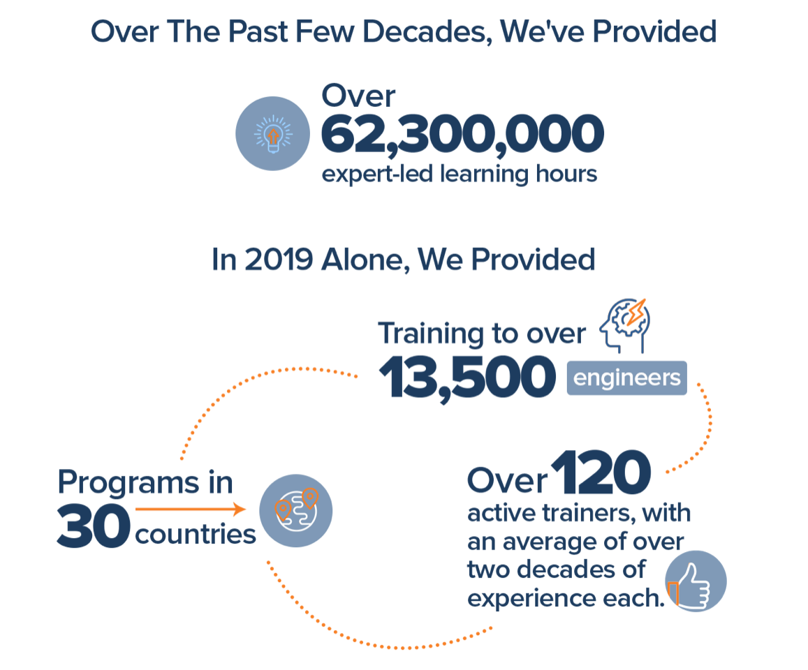
Join Us in Making Learning Technology Easier
Our mission…
Over 16 years ago, we embarked on a journey to improve the world by making learning technology easy and accessible to everyone.
…impacts everyone daily.
And it’s working. Today, we’re known for delivering customized tech learning programs that drive innovation and transform organizations. In fact, when you talk on the phone, watch a movie, connect with friends on social media, drive a car, fly on a plane, shop online, and order a latte with your mobile app, you are experiencing the impact of our solutions.
Copyright DevelopIntelligence LLC
Notes:
ACTION: Share a bit about DevelopIntelligence
- As developers you want to learn!
- As a corporation you want your developers to align their learning with your business goals.
- That’s where we come in… Keeping developers current, bringing others up-to-speed … all aimed at moving your business forward!
- DI was started in 2003 by a Sun Microsystems developer that wanted to help developers level-up and see business better leverage IT

Slide 3
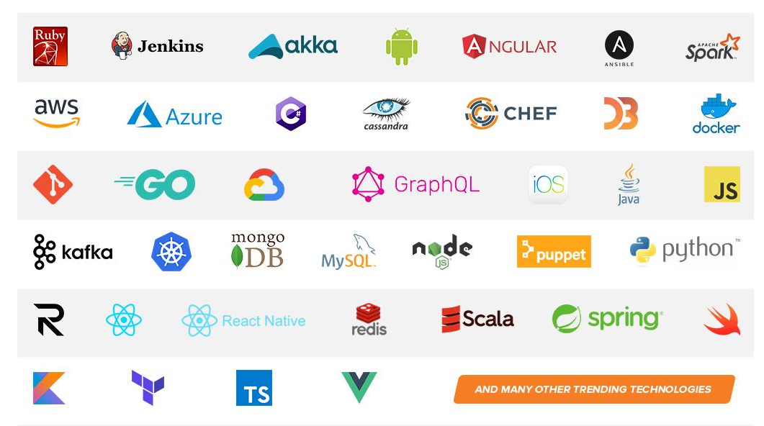
Technologies we cover
Notes:
ACTION: Share some of the technologies we teach
Areas of DevelopIntelligence expertise
DevOps: Ansible / Jenkins
BigData: Hadoop / Cassandra / Spark
Machine Learning
Front-end: React / Angular
Cloud: AWS / Azure / Google Cloud
- Started as a Java shop -> kept growing -> haven’t looked back
- Our specialty is hiring expert practitioners that can come alongside teams and teach them how to move forward

Slide 4
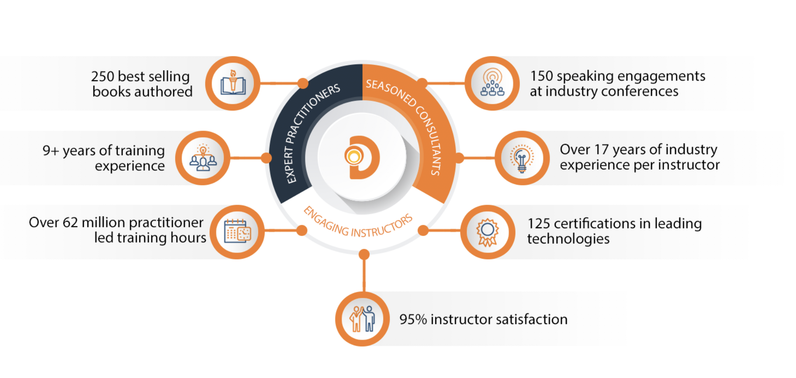
World Class Practitioners
Notes:
ACTION: Share about what makes the DevelopIntelligence instructor team one of-a-kind!
Here is some data showing instructors are expert practitioners, engaging instructors, seasoned consultants. We are the best in the business!

Slide 5



Virtual Training Expectations for You
Arrive on time / return on time Mute unless speaking Use chat or ask
questions verbally
Notes:
ACTION: Share the expectations you have for the students
Level set the rules of engagement for virtual classrooms. Encourage students to be on time! Just because this is a virtual class doesn’t mean it’s ok to inconvenience peers who showed up on time.
Mute yourself unless asking a question/commenting
Ask questions (verbally or via chat window)

Slide 6
Virtual Training Expectations for Me
I pledge to:
Make this as interesting and interactive as possible
Ask questions in order to stimulate discussion
Use whatever resources I have at hand to explain the material
Try my best to manage verbal responses so that everyone who wants to speak can do so
Quick review of key Zoom features that may be helpful for our course
Notes:
ACTION: Share the expectations the students should have for you
Level set to the students what they can expect from you. Instructor will do the best to mix it up…
Zoom tools, hands-on, breaks, group work, break out rooms… keep it interesting and interactive

Slide 7
Purpose
Gain a deeper understanding of IoT data management at scale

Slide 8
Objectives
Upon completion of this course, you should be able to:
Describe device telemetry
Explain the different IoT communications protocols
Understand how and why MQTT is used
List the stages of data management within IoT
Describe how machine learning and artificial intelligence are used with IoT data
Differentiate between monitoring and control

Slide 9
Introduction

Slide 10
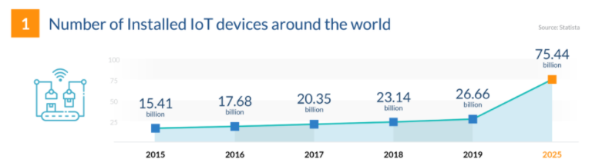
Industry Trends
From https://financesonline.com/iot-trends
Challenges potentially encountered with that amount of projected growth?

Slide 11
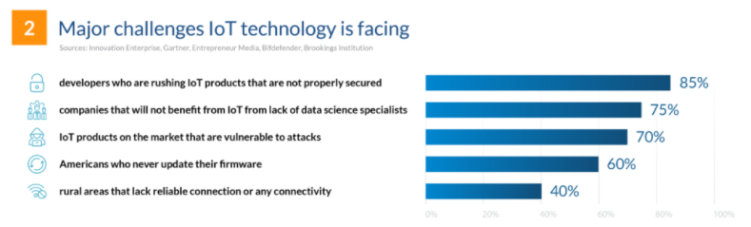
Industry Trends
From https://financesonline.com/iot-trends
Options for mitigating those challenges?

Slide 12
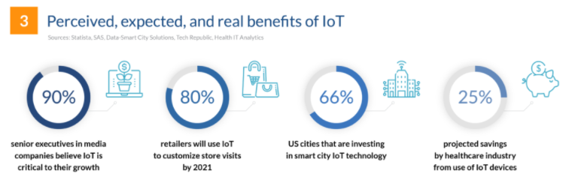
Industry Trends
From https://financesonline.com/iot-trends
How do we help customers realize those benefits?

Slide 13
Industry Trends
Areas of focus:
Accommodating orders of magnitude of growth
Preventing known (or unknown) challenges from impeding success
As a business, effectively leveraging opportunities to meet customer needs
Device Management
Leveraging the Edge
Data Management

Slide 14
Data Management

Slide 15
Device Telemetry
Represents the device payload (e.g., temperature/humidity readings)
Usually time series-based or event driven
Can also include streaming data (e.g., video feeds over time)
Based on number of devices and/or rate, can result in massive amounts of data

Slide 16
Device Telemetry
Transmission may utilize one of multiple protocols (depending on platform):
HTTP
MQTT (Message Queuing Telemetry Transport)
AMQP (Advanced Message Queuing Protocol)
Depending on application, payload may require translation
For example, binary format to JSON or proprietary to common standard
Notes:
There are other protocols but these are the mainstream types
Binary often used on device due to ability to transmit more info using less space (compact)

Slide 17
MQTT Protocol
Lightweight publish/subscribe transport protocol
Requires small code footprint
Message size optimized to preserve network bandwidth

Slide 18
MQTT Protocol
Supports bidirectional communication (D2C & C2D)
Mechanisms for reliable message delivery built in
Can accommodate unreliable networks through persistent sessions

Slide 19
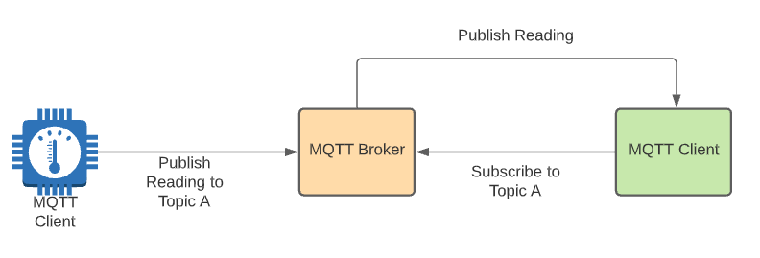
MQTT Protocol

Slide 20
AMQP
Peer-to-peer protocol for message exchange
Does not require broker in middle
Open source vs. vendor driven
More powerful (but also “heavier”) than MQTT

Slide 21
MQTT vs. AMQP
MQTT | AMQP
Simpler | More sophisticated
Mostly vendor-driven | Open source and customer-driven
Simple publish-subscribe | Multiple message exchange options
Non-transactional | Transactional
Exclusively broker-based | Peer-to-peer
Smaller footprint | Larger footprint
Better fit for resource-constrained integrations | Better-fit for more complex integrations

Slide 22
MQTT Protocol – Drilldown
With IP based protocols (TCP or UDP), generally concerned with:
QoS (Quality of Service)
Reliability of data packets
Packet or data loss
Latency
Speed & efficiency
Security

Slide 23
MQTT Protocol – Drilldown
Publish/subscribe (aka pub/sub) helps promote reliability in message exchange
Intermediate broker helps manage the exchange
Keeps sender/receiver loosely coupled to one another
MQTT includes support for QoS configuration as well

Slide 24
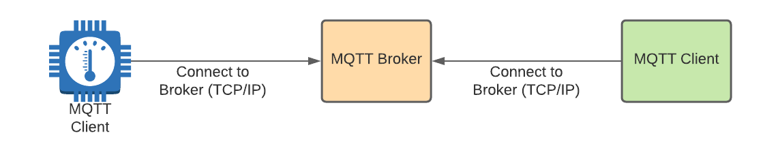
MQTT Protocol – Broker Connection
First step to enabling pub/sub integration:

Slide 25
MQTT Protocol – Topics
Messages are transmitted with MQTT using topics
Topic is a case-sensitive name that defines a “bucket” for message data
Supports hierarchical organization of “bucket” names
Can publish or subscribe to specific “bucket” along the hierarchy
Also supports wildcards for subscribers

Slide 26
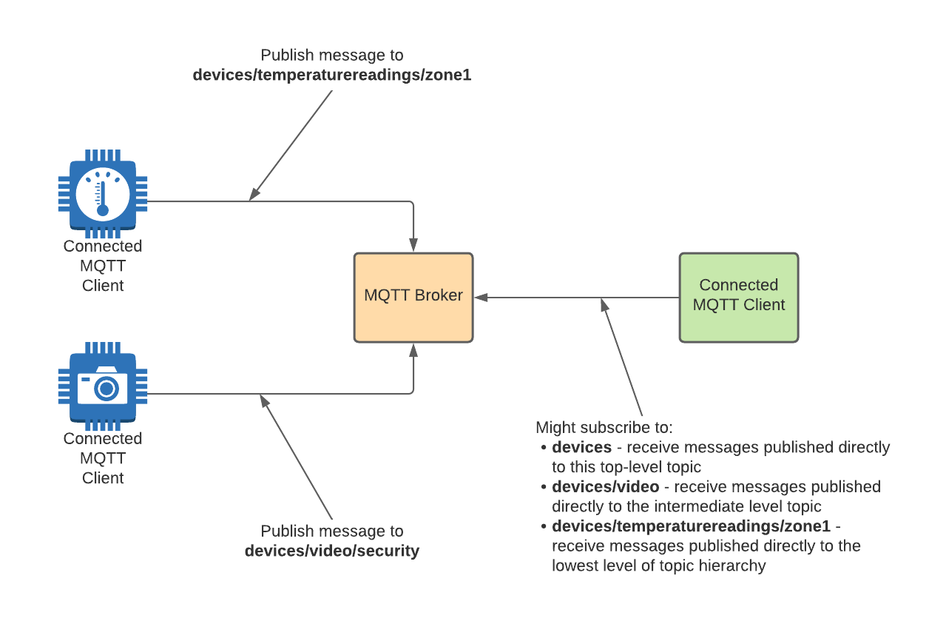
MQTT Protocol – Topics

Slide 27
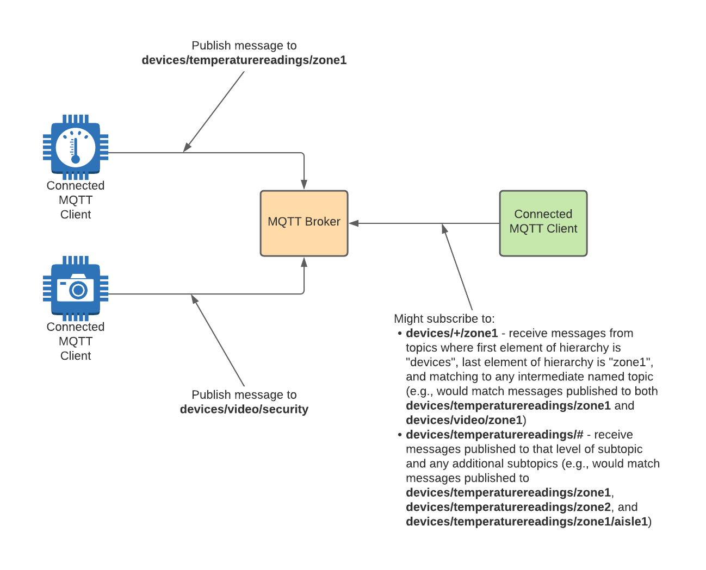
MQTT Protocol – Wildcard Topics

Slide 28
MQTT Protocol – Wildcard Topics
Be wise about the use of wildcard topics
Otherwise, potentially run the risk of large volumes of message “noise”
Subscriber may be required to filter out several unnecessary messages

Slide 29
MQTT Protocol – Wildcard Topics
Also puts additional strain on broker
Be as specific and as targeted as possible with messaging
Balance against convenience of wildcards for relevant use cases

Slide 30
MQTT Protocol – Message Structure
Every MQTT message packaged within a “control packet”
Like an envelope that contains context and data for a message
Focus is on keeping message compact – max 260 MB (but most are smaller)

Slide 31
MQTT Protocol – Message Structure
Control packet includes:
Fixed header – required; includes packet type and size info
Variable header – optional; includes protocol info and may include auth credentials
Payload – optional; may contain message data

Slide 32
MQTT Protocol – Control Packet Types
Control packet types include:
There are others primarily utilized with QoS levels
Type | Transmission Direction | Purpose
CONNECT | Client to Server | First packet sent from client after establishing connection
CONNACK | Server to Client | Acknowledgment of CONNECT
PUBLISH | Client to Server, Server to Client | Transmit new message
SUBSCRIBE | Client to Server | Requesting subscription to one or more topics
UNSUBSCRIBE | Client to Server | Unsubscribe from one or more topics
DISCONNECT | Client to Server | Indicates clean disconnect from server

Slide 33
MQTT Protocol – QoS Levels
Available Quality of Service levels in the protocol:
QoS 0 – Fire and forget; no attempt made by sender to retry
QoS 1 – At least once; sender retries until receiver sends PUBACK control packet
QoS 2 – At most once; at protocol level, series of control packets exchanged to ensure delivery without duplication
Be aware – not all target platforms will support

Slide 34
MQTT Protocol – Libraries
Multiple utility libraries available to facilitate MQTT connectivity
Supports multiple platforms and languages
Insulates from many of the low-level details of MQTT

Slide 35
Data Management – Stages
Ingestion
Scrubbing & Normalization
Aggregation
Analysis & Intelligence Gathering

Slide 36
Data Ingestion
Includes telemetry information previously discussed
Could be via message exchange or streaming
Depending on size/scope, may translate to LARGE amounts of incoming data
Ingestion
Scrubbing & Normalization
Aggregation
Analysis & Intelligence Gathering

Slide 37
Data Ingestion
Because of potential scale, bandwidth may be a concern
Depending on application, latency may also be a concern
Data may require translation (e.g., from low-level bytes to object or JSON)
Ingestion
Scrubbing & Normalization
Aggregation
Analysis & Intelligence Gathering
Notes:
Medical info, autonomous vehicles, streaming data may be less tolerant of latency issues

Slide 38
Data Ingestion
Event hubs or streaming analytics platforms support ingestion at scale
Provide time and context-aware processing for correct sequencing
Data may flow through intermediate storage on way to final processing
Depending on sensitivity of data, could require robust security at each stop
Ingestion
Scrubbing & Normalization
Aggregation
Analysis & Intelligence Gathering

Slide 39
Data Scrubbing & Normalization
Depending on payload, some portions of the data may not be needed
Or some portions might contain sensitive detail
Those parts not needed or sensitive can be “scrubbed” to exclude
Ingestion
Scrubbing & Normalization
Aggregation
Analysis & Intelligence Gathering

Slide 40
Data Scrubbing & Normalization
Represents another potential optimization that can preserve storage
In other cases, similar data may be coming in multiple, disparate formats
For example, 2 different temperature sensors both providing temp/humidity detail
Ingestion
Scrubbing & Normalization
Aggregation
Analysis & Intelligence Gathering

Slide 41
Data Scrubbing & Normalization
Normalization can bring consistency to the disparate content
By normalizing, becomes a single dataset for comprehensive analysis
Normalization may happen as part of ingestion or as part of a separate step
Ingestion
Scrubbing & Normalization
Aggregation
Analysis & Intelligence Gathering
Notes:
Temperature/humidity is temp/humidity – regardless of the device and how the device communicates it

Slide 42
Data Aggregation
Helps provide full picture of data from multiple streams
May also be used to enrich with info from other data sources
Data will be stored in persistent storage for downstream analysis & reporting
Ingestion
Scrubbing & Normalization
Aggregation
Analysis & Intelligence Gathering

Slide 43
Data Aggregation
In statistical analysis, the larger the sample size, the more accurate the inference
To manage costs, large sets of data may leverage different types of storage:
Hot storage – most recent data and most relevant for current analysis
Cool storage – data not actively used but potentially relevant (short-term trends)
Cold or archive storage – data kept for historical purposes and long-term trending
Security of the stored data and encryption at rest become critical
Ingestion
Scrubbing & Normalization
Aggregation
Analysis & Intelligence Gathering

Slide 44
Data Analysis & Intelligence Gathering
In the digital age, data is the competitive edge
Companies that manage their data as a critical asset succeed
Keys:
Aggregating efficiently
Analyzing effectively
Ingestion
Scrubbing & Normalization
Aggregation
Analysis & Intelligence Gathering

Slide 45
Data Analysis & Intelligence Gathering
Goal is to identify and leverage the most important data points
Importance is measured by business value-driven decision-making
What can I learn about today’s customers, scenarios, or business cases?
What can I effectively predict about tomorrows?
Ingestion
Scrubbing & Normalization
Aggregation
Analysis & Intelligence Gathering

Slide 46
Data Analysis & Intelligence Gathering
Requires balancing of competing concerns:
To increase quality of intelligence, more data is required (sometimes MUCH more)
But massive datasets can be complex to manage and process
Ingestion
Scrubbing & Normalization
Aggregation
Analysis & Intelligence Gathering

Slide 47
Data Analysis & Intelligence Gathering
Enter ML / AI:
Algorithms are used to build mathematical models from existing data
Results in a mathematical “trajectory” (and confidence level)
Algorithms can be configured to learn and improve over time
Hyperscale available in the Cloud brings near-limitless power to bear
Ingestion
Scrubbing & Normalization
Aggregation
Analysis & Intelligence Gathering

Slide 48
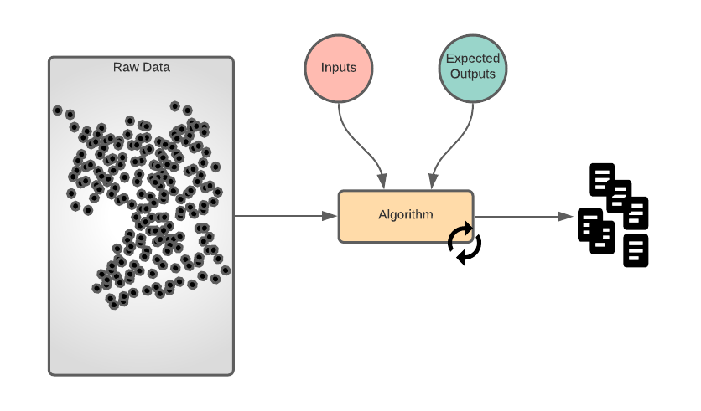
Supervised Learning
Ingestion
Scrubbing & Normalization
Aggregation
Analysis & Intelligence Gathering
Notes:
Refresher

Slide 49
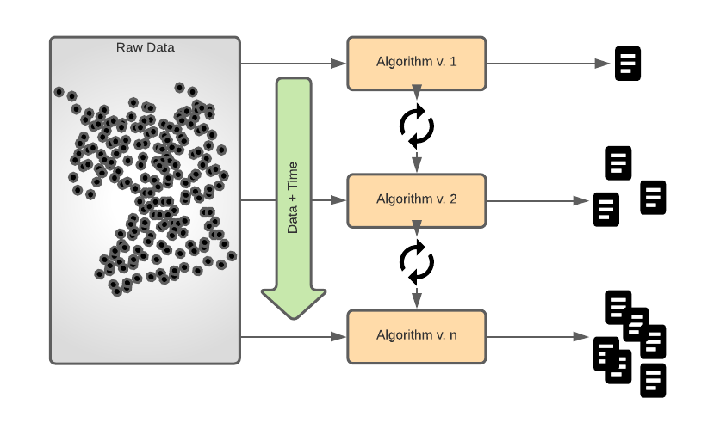
Unsupervised Learning
Ingestion
Scrubbing & Normalization
Aggregation
Analysis & Intelligence Gathering
Notes:
Refresher

Slide 50
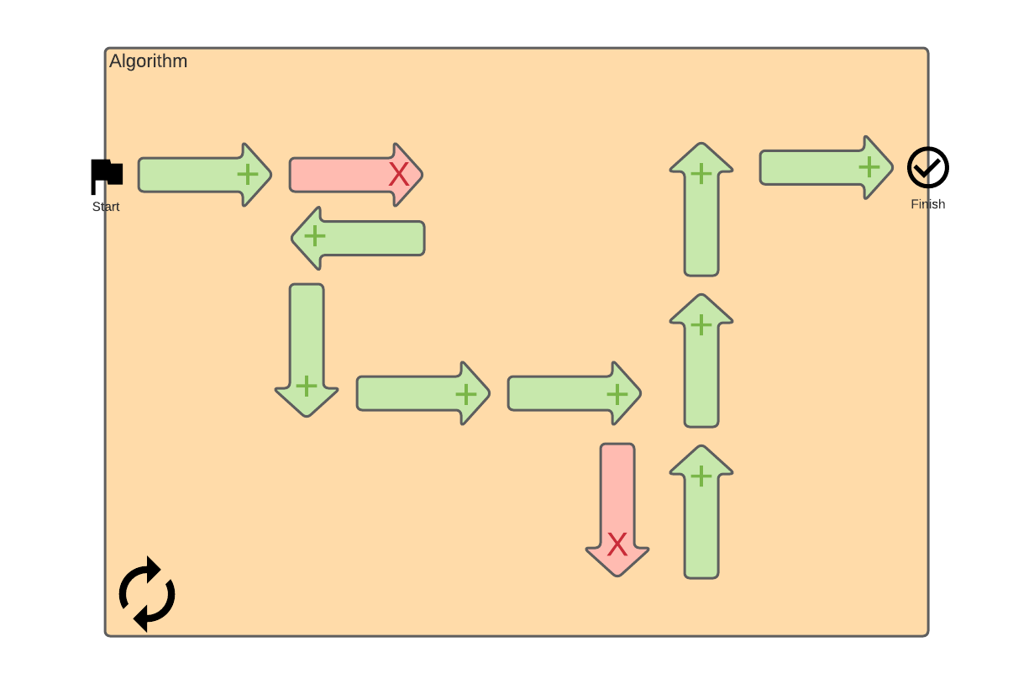
Reinforcement Learning
Ingestion
Scrubbing & Normalization
Aggregation
Analysis & Intelligence Gathering
Notes:
Refresher

Slide 51
Monitoring vs. Control
Monitoring tracks key information over time
Ingestion + Intelligent Analysis → Proactive Response Opportunities
Leveraged on dashboards for snapshot views
Leveraged in alerts to notify of negative conditions or negative trending
Ingestion
Scrubbing & Normalization
Aggregation
Analysis & Intelligence Gathering

Slide 52
Monitoring vs. Control
Control includes C2D (Cloud-to-Device) instruction or configuration
In response to intelligence gathered, can automatically adjust operations
Can also include updates to operating configuration
Security requirements may be stricter for control
Ingestion
Scrubbing & Normalization
Aggregation
Analysis & Intelligence Gathering

Slide 53
Case Study
Case Study is focused on modernization and digitization of an in-home nursing assistance service. Current state:
Service maintains in-home care with in-person, routine visits every 4 days
~400 patients within a 125-mile radius of a major metropolitan area
Routine visits include checking vitals, delivery of medication, and, in some cases, special care
Average age of patients is 71+ years old
Patients will not be able to administer any IT infrastructure installed in the home
Network connectivity can be inconsistent at times with intermittent, temporary drops
Historical data tracking is important to assess quality of patient care and identify potential improvements
HIPAA regulations (health privacy) dictate a need for responsible stewardship of the data
What questions would you ask to gain additional requirements information around target data?
If you were going to implement an Edge/IoT solution for this case study, what types of data would you anticipate needing to track?
What kind of challenges do you anticipate encountering with implementation, especially with respect to data telemetry, data management, monitoring, control, etc.?

Slide 54
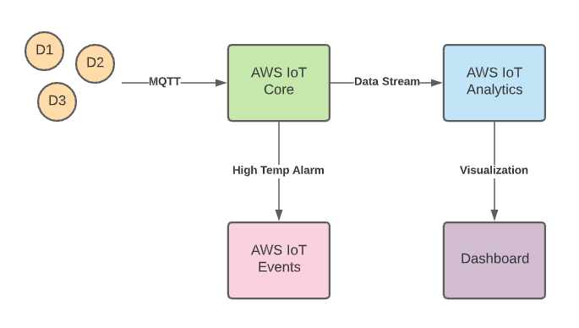
Demo

Slide 55
THANK YOU

